Slide 1
Marianna Zhang
Why do different category representations matter?
Downstream consequences on normativity, possibility of change, target of intervention
Markman lab meeting
9.17.2020
Notes:
Walk through some of my recent thinking, present a sketch of a potential study, get feedback on study design

Slide 2
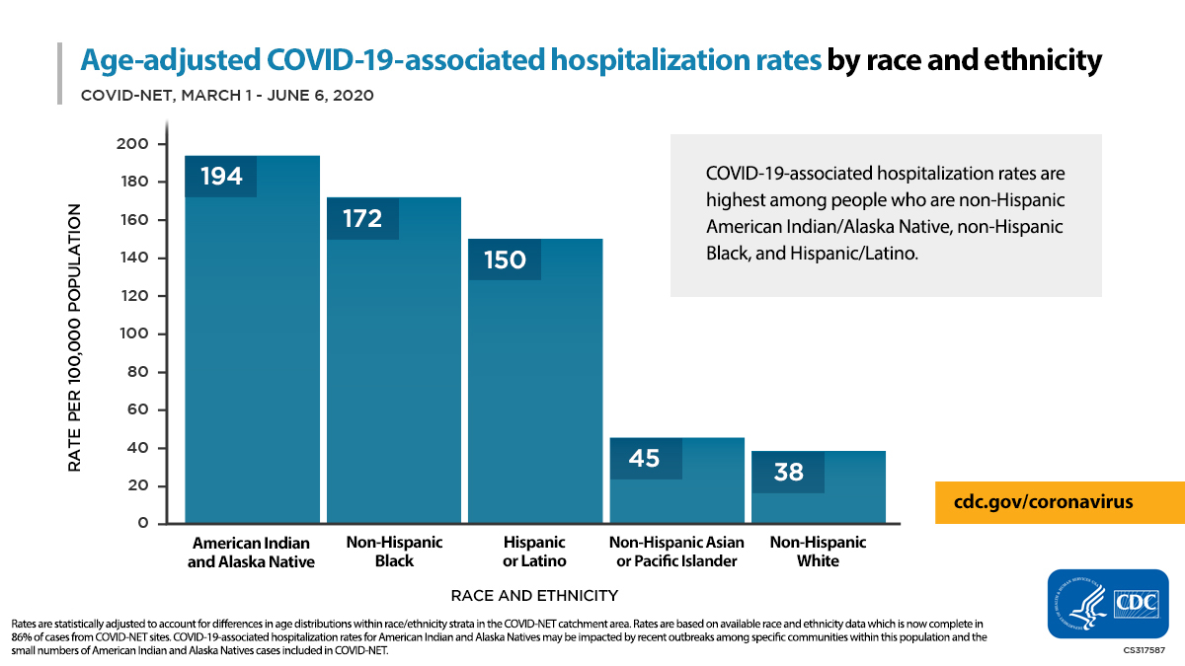
We observe different frequencies of a property across categories.
Notes:
When we look out at the world, we notice that some properties distributed differently across different categories.
For instance, during the current pandemic, Black (along with indigenous and Latinx) people have faced higher rates of infection by COVID-19 than other racial groups.

Slide 3
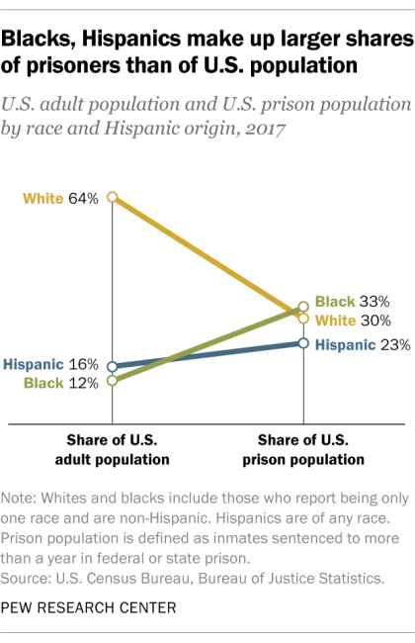
We observe different frequencies of a property across categories.
Why?
Black people are:
- disproportionately infected by COVID-19.
- disproportionately incarcerated.
Notes:
And if we look at who goes to jail, we see that Black people face higher rates of incarceration than other racial groups, as indicated by the steep green line.
We can say that Black and Latinx people are disproportionately…
Might wonder, why is that the case? What might account for the different statistical frequencies observed?

Slide 4
Reasoning about different frequencies of a property across categories
Black people are:
- disproportionately infected by COVID-19.
- disproportionately incarcerated.
Why?
Non-accidental
Accidental
Due to some cause.
Triggers search for causal-explanatory structure.
Due to chance.
Nothing meaningful here, differences in frequency are not significant.
?
COVID-19
COVID-19
Notes:
Accidental – Nothing meaningful here to think about further. Statistically not significant.
Non-accidental – Something meaningful here, some causal structure to uncover. Concluding non-accidental is already powerful (ELLEN: eg climate change: are these past few seasons significantly non-accidentally hotter?)
Let’s say we think the differences are non-accidental. Triggers search for an explanation. What might the cause be?

Slide 5
Different causal models
Black people are:
- disproportionately infected by COVID-19.
- disproportionately incarcerated.
Why?
Black people are biologically predisposed or vulnerable to COVID-19. ..
Black people work jobs with high risk of exposure, jobs are still in-person and require commuting, healthcare discrimination…
COVID-19
COVID-19
Notes:
Causes internal to the category, vs external to the category
(social determinants of health)

Slide 6
Different causal models
Black people are:
- disproportionately infected by COVID-19.
- disproportionately incarcerated.
Why?
Black people are predisposed to crime, have a culture that encourages crime…
Black people are targeted by mass incarceration policies…
prison
prison
Notes:
Different explanatory frameworks, or causal models

Slide 7
Different causal models
Property is disproportionately frequent among members of a category for non-accidental reasons.
Why?
Internalist model
e.g. essentialist model
Structural model
stable external cause (i.e. structural context) that operates on members of a category and causally produces properties
cause internal to the category (e.g. essence) that causally produces properties
property
property
Notes:
Causes internal to the category, vs external to the category
Different explanatory frameworks, or causal models, to explain why that category disproportionately has that property
NICKY: Culture as in-between, external to any single individual/category member, but internal to category. For these purposes more internal, since it’s not a factor external to the whole category

Slide 8
Different causal-explanatory models
What kinds of input?
Internalist model
e.g. essentialist model
Structural model
stable external cause (i.e. structural context) that operates on members of a category and causally produces properties
cause internal to the category (e.g. essence) that causally produces properties
property
property
Notes:
Previous projects: What kinds of input lead us to one model or another?

Slide 9
Different causal-explanatory models
What kinds of input?
Statistical evidence
Property is disproportionately frequent among that category.
Internalist model
e.g. essentialist model
Structural model
stable external cause (i.e. structural context) that operates on members of a category and causally produces properties
cause internal to the category (e.g. essence) that causally produces properties
property
property
Notes:
Statistical pattern can clearly be consistent with either

Slide 10
Different causal-explanatory models
What kinds of input?
Statistical evidence
Property is disproportionately frequent among that category.
Language
Generics: “Black people end up in prison.”
Formal explanations: “He ended up in prison because he’s Black.”
Internalist model
e.g. essentialist model
Structural model
stable external cause (i.e. structural context) that operates on members of a category and causally produces properties
cause internal to the category (e.g. essence) that causally produces properties
property
property
Notes:
Some kinds of language like generics and formal explanations have been argued to be cues for an internalist model, but mounting evidence suggests both kinds of language can support either model

Slide 11
Different causal-explanatory models
What kinds of input?
Internalist model
e.g. essentialist model
Structural model
stable external cause (i.e. structural context) that operates on members of a category and causally produces properties
cause internal to the category (e.g. essence) that causally produces properties
property
property
Notes:
I’ve focused mostly on this question of what kinds of input lead to each model, because ideally once we understand that, we can understand what kinds of input to provide, to promote one model or another.

Slide 12
Different causal-explanatory models
What kinds of input?
Internalist model
e.g. essentialist model
Structural model
stable external cause (i.e. structural context) that operates on members of a category and causally produces properties
cause internal to the category (e.g. essence) that causally produces properties
property
property
What are the downstream consequences of these models?
Notes:
- But which model do we want to promote? Why does it matter which model people use to explain category properties? What are the downstream consequences…
- I have the intuition that these models are really different in important ways, but… it’s possible to think that eh whichever model you take to be the case, you’re looking out at the same pattern of statistical evidence at the end of the day.

Slide 13
Structural model
Different causal-explanatory models
Internalist model
e.g. essentialist model
stable external cause (i.e. structural context) that operates on members of a category and causally produces properties
cause internal to the category (e.g. essence) that causally produces properties
property
property
What are the downstream consequences of these models?
Notes:
Although we might be looking at the same pattern of statistical evidence, of what is the case, depending on what model we take, we might have different attitudes about that evidence. I’ll describe 3 downstream attitudes, but curious if people have ideas for more.

Slide 14
Structural model
Different causal-explanatory models
Internalist model
e.g. essentialist model
stable external cause (i.e. structural context) that operates on members of a category and causally produces properties
cause internal to the category (e.g. essence) that causally produces properties
property
property
What are the downstream consequences of these models?
Normativity What should be the case?
Possibility of change How possible is it to change what is the case?
Target of intervention How might we change what is the case?
Other consequences? (If property is negative, blame/responsibility? might be low for both one specific form of internalism (biological essentialism) AND structural though)
Homogeneity: biological cause as pretty deterministic, vs structural cause as noisier
Context-dependence: if you remove context or move category members out of context
Notes:
NICKY: immediate normative judgments first, and then post-hoc reasoning about model to justify? but there's room between seeing a pattern and arriving at normativity, eg receiving immediate expl, we don’t judge every statistical norm to be normative
DAVID: do these just come down to controllability at the end of the day?
Although we might be looking at the same pattern of statistical evidence, of what is the case, depending on what model we take, we might have different attitudes about that evidence.
In particular, we might have different attitudes about: 1) what should be the case. Is it okay that category members disproportionately exhibit this property? Would it okay if a category member didn’t? Would it be okay if a non-category member did?
whether it’s possible to change what’s currently the case, and how one would even go about changing what’s currently he case. Tobi: different causal models should support different interventions.

Slide 15
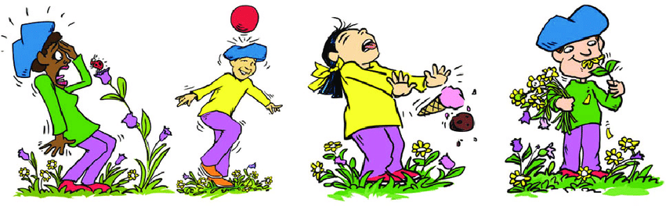

Structural condition
What are the downstream consequences of these models?
Intro & induce construal > Measures: Possibility of change > Normativity > Intervention
Adults (MTurk), although ideally paradigm can be easily run with children too (online)
Introduce property of novel social group:
On a planet far far away, there is a group of people called Zarpies.
Let’s learn about Zarpies!
Zarpies sleep 7 hours a day.
Induce construal by providing different explanations for property between-subjects:
Internalist condition
wind
bio
Because of the way their bodies work, Zarpies wake up after sleeping for 7 hours.
Because the morning wind is very loud where they live on the planet, Zarpies wake up after sleeping for 7 hours.
sleep 7hr
sleep 7hr
Notes:
Feedback:
Does this study seem like it would work? If so, in a way that isn’t a mere trivial manipulation check, in a way that successfully addresses the question?
If scenario seems too artificial or contrived

Slide 16
What are the downstream consequences of these models?
Intro & induce construal > Measures: Possibility of change > Normativity > Intervention
Fixed vs random order?
Possibility of change – possible for category members to not have property?
Normativity – attitude towards category member without property
Focus of intervention – if you want to change the property, intervene on what?
Notes:
Feedback: fixed or random order?

Slide 17
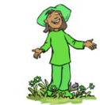
What are the downstream consequences of these models?
Intro & induce construal > Measures: Possibility of change > Normativity > Intervention
Possibility of change – possible for category members to not have property?
If a Zarpie wanted to try to sleep 10 hours a day, do you think they could come up with a way to sleep 10 hours a day? (Y/N + open-ended explanation)
Internalist:
No, impossible/not as possible
(physiologically impossible)
Structural:
Yes, possible
(come up with a way to block the wind, use earplugs, come up with a way to stop the wind)
wind
bio
? X
sleep 7hr
? X
sleep 7hr
Notes:
NICKY: Haslam: biological essentialism of sexual orientation → strong views of sexuality but not correlated w prejudice, but had other negative consequences

Slide 18
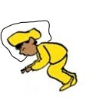
What are the downstream consequences of these models?
Intro & induce construal > Measures: Possibility of change > Normativity > Intervention
Normativity – attitude towards category member without property
Look, here is a Zarpie who sleeps 10 hours a day. Is it okay or not okay that this Zarpie sleeps 10 hours a day? (okay/not okay)
Internalist:
Not okay
(something wrong with their body)
Structural:
Okay
(fine for them to sleep longer, maybe they’ve figured out to sleep through the wind)
wind
bio
X
X
sleep 7hr
sleep 7hr

Slide 19

What are the downstream consequences of these models?
Intro & induce construal > Measures: Possibility of change > Normativity > Intervention
Focus of intervention – if you want to change the property, intervene on what?
The Zarpies are very tired. Zarpies have been sleeping 7 hours, but it’s not enough sleep, they need more sleep! Luckily, there’s a smart scientist visiting from Earth. The scientist knows a lot about a lot of things, like what goes on inside people's bodies, and how weather works. The scientist wants to work on and change something to help the Zarpies sleep more. What should the scientist work on: the Zarpies or the Zarpies' planet? (Zarpies/Zarpies’ planet)
wind
Internalist:
Zarpies
(target the cause: biology of their bodies)
Structural:
Zarpies’ planet
(target the cause:
planet’s loud morning wind)
bio
sleep 7hr
sleep 7hr
Notes:
Conflated with how hard each of these things is to change? People’s bodies vs weather/engineering earplugs. Internal causes generally harder to change than external causes?
Manipulation check

Slide 20
Structural model
What are the downstream consequences of these models?
Adults (MTurk), although ideally paradigm can be easily run with children too (online)
Introduce property of novel social group (Zarpies).
Experimentally induce: (between-subjects)
Internalist model
e.g. essentialist model
stable external cause (i.e. structural context) that operates on members of a category and causally produces properties
cause internal to the category (e.g. essence) that causally produces properties
property
property
Measures: (fixed vs random order?)
Possibility of change – possible for category members to not have property?
Normativity – attitude towards category member without property
Focus of intervention – if you want to change the property, intervene on what?

Slide 21
Intro
Construal
Possibility of change (Y/N + open-ended)
Normativity (okay/not okay)
Intervene
Zarpies sleep 7 hours a day.
Internalist Because of the way their bodies work, Zarpies wake up after sleeping for 7 hours. | Structural Because the morning wind is very loud on their planet…
If a Zarpie wanted to try to sleep 10 hours a day, do you think a Zarpie could come up with a way to sleep 10 hours a day?
Look, here is a Zarpie who sleeps 10 hours a day. Is it okay or not okay that this Zarpie sleeps 10 hours a day?
Zs tired, need more sleep… scientist knows a lot: what goes on inside people's bodies, how weather works… What should the scientist work on: the Zarpies or the Zarpies' planet?
Zarpies eat lots of carrots.
Internalist Carrots contain special nutrients that Zarpies need to grow. | Structural Not much can grow on planet besides carrots, so most of what grows on the planet is carrots.
If a Zarpie decided to travel the universe, and came to our planet, do you think they would eat lettuce instead of carrots?
Look, here is a Zarpie who eats lettuce instead of carrots. Is it okay or not okay that this Zarpie eats lettuce?
?
Zarpies can’t swim.
Internalist Because of the way their bodies work, Zarpies sink in the water. / Because naturally afraid, avoid water. | Structural Because there is no water on their planet, Zarpies haven’t learned to swim.
If a Zarpie wanted to learn to swim, do you think they could learn to swim?
Look, here is a Zarpie who visited planet Earth. This Zarpie can swim. Is it okay or not okay that this Zarpie can swim?
Zarpies built a pool and decided they want to swim. Can you help? Someone who knows a lot about how bodies work, someone who knows how to swim. Which person can help Zs swim?
Zarpies live in X.
Internalist Because they like .. And X has lots of .., Zarpies live in X. | Structural Because they have not been allowed to live anywhere else, Zarpies live in X.
If a Zarpie could go anywhere in the world, would Zarpies live in X?
Look, here is a Zarpie who does not live in X. Is it okay or not okay that this Zarpie …..
Zarpies built a pool and decided they want to swim. Can you help? Someone who knows a lot about how bodies work, someone who knows how to swim. Which person can help Zs swim?

Slide 22
Intro: contrast class | There are 2 kinds of people who live on this planet: Zarpies and Vawns. Zarpies live here, on this part of the planet. Vawns live here, on that side of the planet.
Property: generic | Zarpies sleep 5 hours a day. Vawns sleep 10 hours a day. |  |  | Zarpies eat pogoberries. Vawns eat okinberries. |  |  | Zarpies are 3 feet tall. Vawns are 5 feet tall.
Intro: Zarpies focus | Today we’re going to learn about Zarpies.
Construal | Internalist (biology) Because of the way their bodies work, Zarpies wake up after sleeping for 5 hours. | Internalist (cultural) Because they go to sleep when the moon is high in the sky, and wake up at sunrise to pray, Zarpies wake up after sleeping for 5 hours. | Structural Because there are lots of loud factories in their part of the planet, Zarpies wake up after sleeping for 5 hours. | Internalist (biology) Because of the way their bodies work, other berries make them sick, so Zarpies only eat pogoberries. | Internalist (cultural) Because other berries are considered taboo in their culture / (kid-friendly: they believe eating other berries is wrong), Zarpies only eat pogoberries. | Structural Because pogoberries are the only berries that grow in the area where they live, Zarpies only eat pogoberries. | Internalist (biology) Because of the way their bodies work, Zarpies stop growing after they grow to 3 feet tall. | Structural Because the food available in their area is not very nutritious, Zarpies stop growing after they grow to 3 feet tall.
Possibility of change (Y/N, scale) | Would it be possible for a Zarpie to sleep 10 hours a day? / Can Zarpies sleep 10 hours a day? |  |  | Would it be possible for a Zarpie to eat okinberries? / Can Zarpies eat okinberries? |  |  | Would it be possible for a Zarpie to grow to 5 feet tall?
Normativity (okay/not okay + 3-point scale) | Look, here is a Zarpie who sleeps 10 hours a day. Is it okay or not okay that this Zarpie sleeps 10 hours a day? |  |  | Look, here’s a Zarpie who eats okinberries. Is it okay or not okay that this Zarpie eats okinberries? |  |  | Look, here’s a Zarpie who is 5 feet tall. Is it okay or not okay that this Zarpie is 5 feet tall?
Intervene (open-ended, follow-up from possibility of change) | Zs are tired, want to get more sleep. What should we do to help the Zarpies sleep 10 hours a day? Code intervene on internal: change or block internal cause (make a pill that helps them sleep longer, change their culture/values/religion) Code intervene on structure: move out of structural context (move out of wind, to where Vawns live), block structural cause (earplugs), remove structural context (change wind) |  |  | The pogoberry harvest failed this year, and Zarpies want to try eating okinberries. Is there anything we do to help the Zarpies eat okinberries? (Y/N) If so, what could we do? (open-ended) Code intervene on internal: change or block internal cause (make a pill that helps them eat okinberries, change their culture/values/religion) Code intervene on structure: move out of structural context (move to okinberries, to where Vawns live), block structural cause (import okinbrries), remove structural context (?) |  |  | Zs are too short to… ???? What should we do to help the Zarpies grow taller? Code intervene on internal: change or block internal cause (make a pill that helps them grow taller) Code intervene on structure: move out of structural context (move to more nutritious food, to where Vawns live), block structural cause (import better food), remove structural context (make the food more nutritious)
Notes:
Possibility of change – from gender stereotype dev literature (
Traditional flexibility – whether gender/moral/social transgression is possible (“Can boys also play with a toy kitchen?”)
Normativity – from Steven’s studies

Slide 23
 | Internal cause | Structural cause
Cause = low controllability | Genes Biology, eg allergies | Planet’s weather patterns Pollution in particular environment* (depending if category members can easily move out of environment)
Cause = high controllability | Mental states, eg preferences | Lack of resources

